Slide 1
Wesley Life
Predicting Food Insecurity
by PUMA
By: Anthony Esboldt, Jason Nguyen, Eric Pfaffenbach, and Riley Schultz

Slide 2
What Food Insecurity Measures did we find Important?
People who are worried food will run out before they can afford more
Worried about not affording food and or utilities
Once food is figured out families are able to budget better
Should be able to focus on better things than where our next meal is coming from
People who could not afford to eat balanced meals
In order to maintain our health, balanced meals are important
Being unable to afford balanced meals could likely lead to other health complications

Slide 3
Data Handling and Modeling Process
Data Cleaning:
Cleaned and processed CPS and ACS datasets
Variable Engineering:
Variables Edited
Created Proportions
Modeling:
Applied ridge and lasso regression to predict outcomes like food insecurity and balanced meals
Ridge showed slightly better performance
Geospatial Analysis:
Created choropleth maps by joining with PUMA shapefile
Notes:
Data Cleaning: Filtering aggregations, used all demo available in both datasets
Modeling: train/test
Geospatial Analysis: This allows us to more easily understand regional disparities, highlighting areas with higher food insecurity or imbalance in meals and helps us identify target regions for policy interventions or resource allocation.

Slide 4
Variables We Created
Female proportion - female/household size
Using gender proportions of a household did a better job predicting food insecurity measures instead of just using number of females.
Elderly Proportion - elderly / household size
This variable captures the effect of having a higher proportion of elderly individuals in a household.
Income Per Capita - FAMINC / household size
This variable considers the average income per person in a household
Which can be a more accurate measure of economic stress than total household income.

Slide 5
Worried Food Will Run Out
Notes:
Now we will show you the results of our first predictor variable, which is, people worried that food will run out.

Slide 6
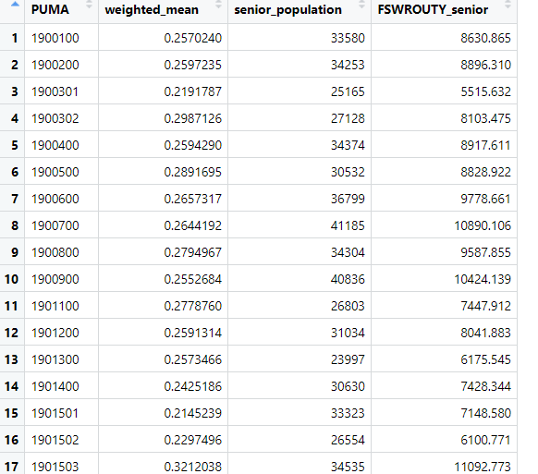
Proportions For Affording Meals
Results gave us weighted averages
Arranged by PUMA ID
Applying Senior Population Data
Notes:
We want to explain how we did it,
We got the ID’s of each puma and then apply the weights into our datasets. To get Puma specific data towards the predictions.

Slide 7
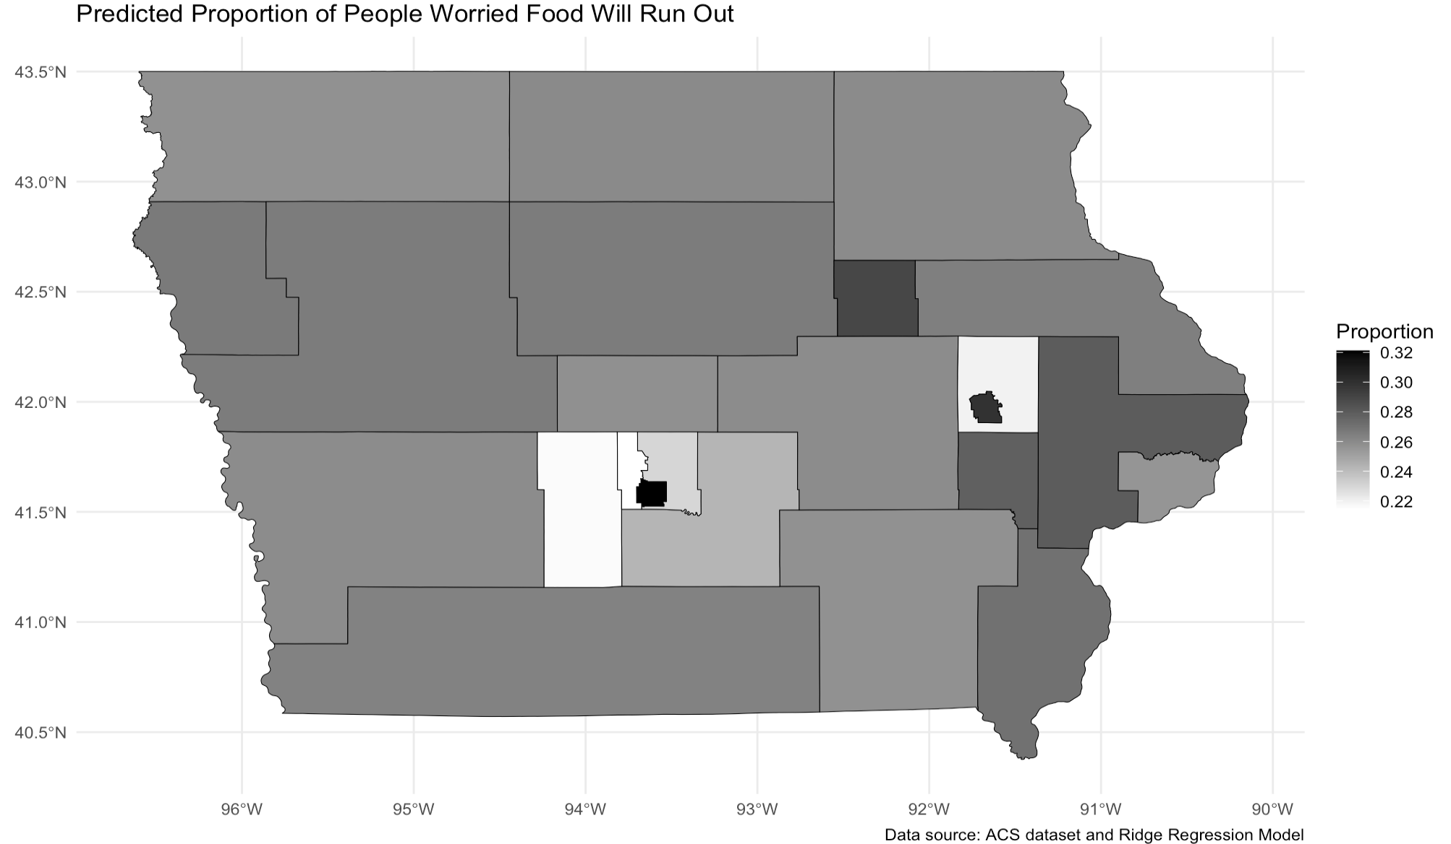
Predicted Proportion of People
Worried Food Will Run Out Per PUMA
Cedar Falls
Sioux City
Waterloo
Dubuque
Cedar Rapids
Des Moines
Davenport
Council Bluffs
Ottumwa
Burlington
Notes:
Overview
After compiling our results, this is the first map we got towards our first variable, proportion of people worried that food will run out.
And for all of our maps we use a white to black color scale, so lighter shades indicate lower proportions and dark shades indicates high proportions. We found that this helps highlights the areas with elevated food insecurity nicely.
This map shows the proportion of individuals of all ages within each PUMA predicted to worry that their food will run out before they can afford more.
Using proportion can help us determine food insecurity because it is the predicted percentage of the total population within each PUMA. For example, Cedar Rapids has roughly a proportion of 0.30, that means 30% of the total population in that area is expected to have this concern.

Slide 8
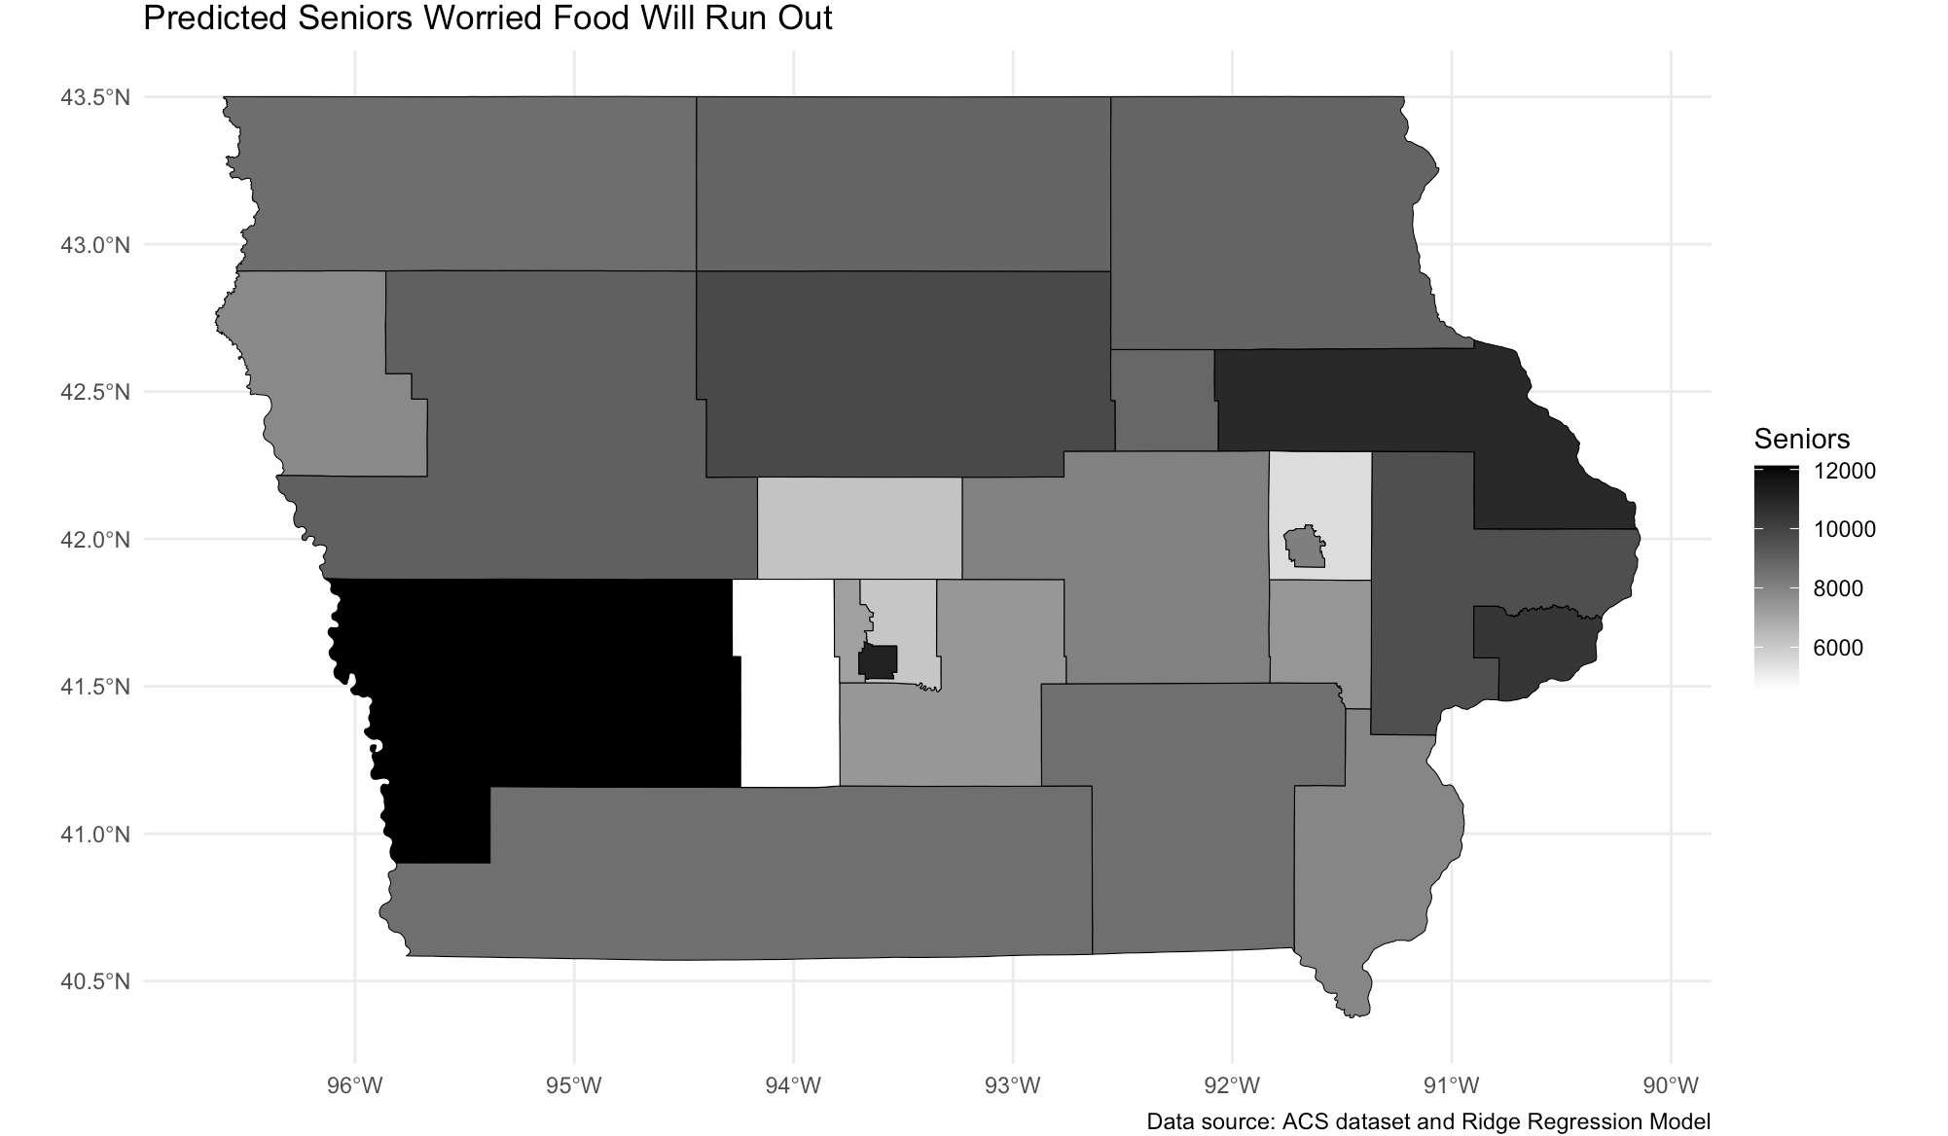
Predicted Number of Seniors Worried Food Will Run Out Per PUMA
Cedar Falls
Sioux City
Waterloo
Dubuque
Cedar Rapids
Council Bluffs
Des Moines
Davenport
Ottumwa
Burlington
Notes:
Overview
This is our second map, and it focuses specifically on seniors.
And this map shows the absolute amount of seniors who are predicted to face food insecurity. If we look at Council Bluffs it is shaded quite dark, and we predict that roughly 12,000 seniors in that area will have worries about food.
It seems that the western and eastern cities of Council Bluffs and Dubuque have the most counts of food insecure seniors.

Slide 9
Cannot Afford a Balanced Meal

Slide 10
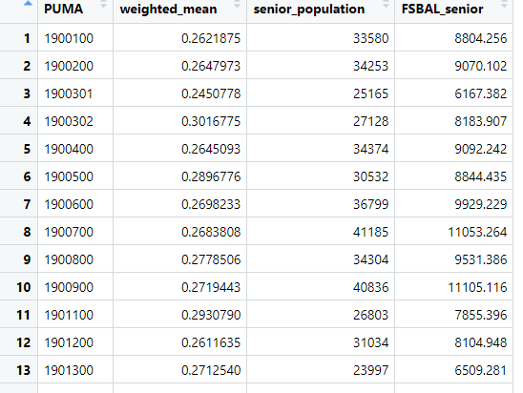
Proportions for Balanced Meal Data
Result data produced weighted means
Organizing by PUMA
Applying Senior by PUMA data

Slide 11
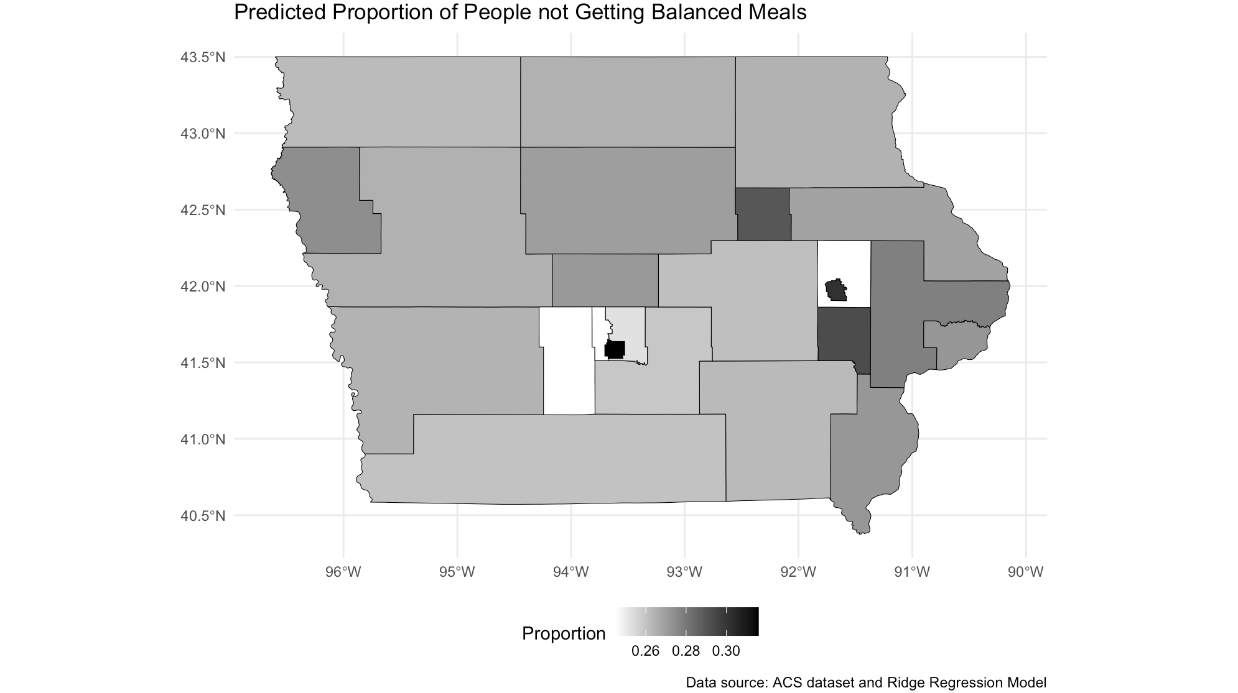
Predicted Proportion of People
Who Cannot Afford Balanced Meals Per PUMA
Sioux City
Cedar Falls
Dubuque
Waterloo
Cedar Rapids
Des Moines
Davenport
Council Bluffs
Ottumwa
Burlington

Slide 12
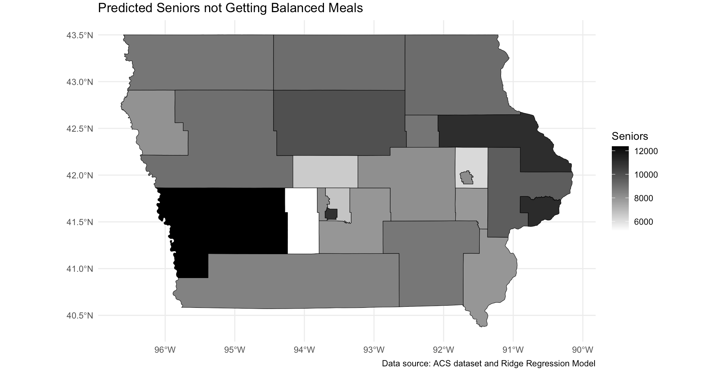
Predicted Number of Seniors
Who Cannot Afford Balanced Meals Per PUMA
Sioux City
Cedar Falls
Dubuque
Waterloo
Cedar Rapids
Des Moines
Council Bluffs
Davenport
Ottumwa
Burlington

Slide 13
Overall Findings
We recommend expanding meals on wheels to the Council Bluffs, Dubuque, or Davenport areas
PUMAS with the estimated greatest number of food insecure seniors
Davenport specifically showed more of a need for balance meals than affordance

Slide 14
Thank You!
Questions?

